Slide 1
Histograms

Slide 2
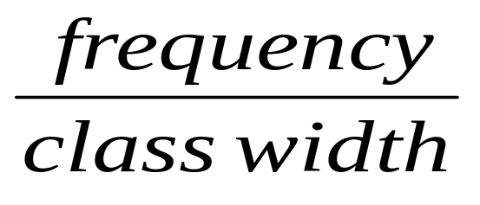
Important points
Class boundaries
Class width = u.c.b. – l.c.b.
Frequency density =

Slide 3
Important points
The bars have no spaces between them
The area of each bar is proportional to the frequency

Slide 4
There are many shapes that a histogram can illustrate. Here are three common ones.
Bell shaped
Skewed right
Bimodal

Slide 5
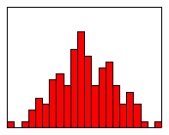
Bell shape

Slide 6
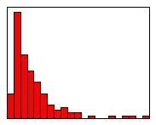
Skewed right

Slide 7
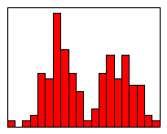
Bimodal

